Slide 1
Q4Cmusic [Quantum computing for Carnatic music ]
Karthick Narayanan Srinivasa Raghavan
IBM Summer Jam 2020 North Carolina
Notes:
Hi, I am Karthick from North Carolina. My idea for the hackathon is Q4CMusic. What’s Q4CMusic you might ask? Q4CMusic expands into Quantum Computing for Carnatic Music. We are delving into an use case application for modelling novel and innovative patterns for a south Indian classical instrument called “Mridangam” using Quantum Computing. Now there are two parts to this question: 1. What’s Carnatic music and what is a mridangam? We will take a short detour giving background information and nomenclature about this music before explaining the design and results.

Slide 2

Background and Nomenclature
Carnatic music is a Classical music form indigenous to the Southern part of India.
Mridangam is a two headed drum made out of layers of cow’s hide.
Mridangam is a very popular percussion instrument and can produce a range of tones and semi tones.
Notes:
Carnatic music or Karnāṭaka Sangīta as it’s called in India, is a system of music commonly associated with the southern part of India. The music is filled with a tremendous range of nuances and aesthetic values retaining the basic religious and spiritual core. South Indian music is also performed all over the world today with artists travelling globally. Mridangam is a popular percussion drum in Carnatic music. Unlike a regular drum, it’s a double headed drum made it multiple layer of cow’s hide on both the sides giving it the ability to produce a range of tones and semi tones. The picture in this slide is an illustration of myself playing the instrument. This ties into why I chose this instrument for modelling the patterns since I am familiar with the intrinsic interworking of the instrument as a student of the art.

Slide 3
Nomenclature
Modelling 9 sounds and 1 silent note, each sound is called a “Stroke”
Modelled strokes are Thaa, Ki, Thom, Nam, Ta, Dhin, Mi, Cha, Chapu
The silent note is called Kaarvai and denoted using a “,” in the application
Notes:
The mridangam can create a wide range of sounds. We are modelling 9 sounds from the most basic lessons taught and 1 silent note since it’s an integral part of the music. Each sound will be called a stroke and the Modelled strokes are Thaa, Ki, Thom, Nam, Ta, Dhin, Mi, Cha, and Chapu. The silent note is called Kaarvai and denoted using a comma in the application.

Slide 4
Problem Statement
Apply Quantum Computing to generate patterns for mridangam using the strokes and their state transitions.
Once the patterns are generated, play it back using a Open source media player like Pyglet.
Why is music such a compelling application for quantum computing?
Modelling state transitions accurately can lead to rediscovering existing patterns, thus proving it’s conformance to the aesthetic of the music.
Extending such transitions leading to newer patterns can increase creativity and understand the dynamics of the instrument and the music.
Notes:
The idea is to apply Quantum Computing to generate patterns for mridangam using the strokes and their state transitions and play the pattern back using an Open Source media player. Why is music such a compelling application for quantum computing? Modelling state transitions accurately can lead to rediscovering existing patterns, thus proofing it’s conformance to the aesthetic of the music. Extending such transitions leading to newer patterns can increase creativity and understand the dynamics of the instrument and the music. We need to define the outcome – Check if the quantum application can regenerate existing patterns from our input states and if we can create new patterns out of it.

Slide 5
Design Principles
Pick out the most elemental strokes
Create a state transition matrix from a bunch of existing patterns
Generate a probabilistic matrix from the transition matrix for pattern generation
Set boundary conditions for some of the strokes to ensure playability of the pattern
Create a Quantum Circuit that would take in an input state and feed through the states to generate the required pattern
Get the generated pattern out of the Quantum Application and play it back using an open source Python API like Pyglet.
Notes:
Step 1 is to Pick out the most elemental strokes out from mridangam which we have already selected and established previously.
Step 2 is to Create a transitional matrix from one stroke to another stroke to pair up likely strokes.
Step 3 would be to create a probabilistic matrix from the transitional matrix with any definite values for a transition but then normalize it before sending it to the Quantum circuit.
Step 4 is to Create boundary conditions for the end. This sets common strokes for the end to ensure playing feasibility. Also setting a starting state to a particular set of strokes and not all of them since it’s against the aesthetic of the music.
For example we would want to start something with the stroke “Mi” or end with a stroke like “Chapu”. Though these are marked unlikely transitions these would need to modelled even more precisely in the next iteration of the application.
We also have the upper boundary for number of strokes to generate a pattern set at 32 since it’s already too long to be considered elementary pattern at that point.
Step 5: How to model the state transition using Quantum circuit in our case is just a simple Hadamard Gate circuit loop which takes an input state and provides the next state.
Final step is to play the pattern from the Quantum application using Opensource Python API like pyglet.

Slide 6
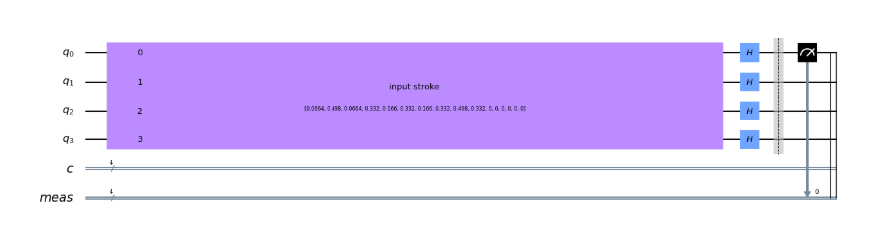
Design Outcomes
State Transition Matrix
Quantum Circuit
Sounds | Thaa | Ki | Thom | Nam | Ta | Dhin | Mi | Cha | Chapu | Kaarvai
Thaa | 10 | 75 | 10 | 50 | 25 | 50 | 25 | 50 | 75 | 50
Ki | 75 | 10 | 75 | 75 | 95 | 50 | 5 | 5 | 10 | 50
Thom | 10 | 75 | 25 | 75 | 25 | 50 | 50 | 50 | 75 | 50
Nam | 50 | 75 | 75 | 25 | 5 | 95 | 95 | 25 | 25 | 50
Ta | 50 | 95 | 95 | 5 | 5 | 5 | 75 | 25 | 5 | 50
Dhin | 50 | 50 | 50 | 95 | 5 | 50 | 95 | 25 | 5 | 50
Mi | 25 | 5 | 50 | 95 | 75 | 95 | 5 | 5 | 5 | 50
Cha | 50 | 5 | 50 | 25 | 25 | 25 | 5 | 5 | 5 | 50
Chapu | 75 | 10 | 75 | 25 | 5 | 5 | 5 | 5 | 5 | 50
Kaarvai | 50 | 50 | 50 | 50 | 50 | 50 | 50 | 50 | 50 | 50
Notes:
These were the design outcomes : On the left we have the list of state transitions that I was able to come up with while analyzing a handful of existing patterns. The states which are more likely are occur have higher values and the unlikely transitions have lower values. On the right we have the quantum circuit for this implementation. It’s a simple 4 qubit Hadamard gate that takes an input state and provides an output state. We then take the corresponding state values for that state and feed the value back into our quantum circuit till we have generated all the stokes.

Slide 7
Results
Successfully completed creating the application
We were able to generate existing patterns with ease up to 12 strokes
As expected we were also able to generate new and novel patterns from our Quantum Application
Generating more than 12 strokes leads to inconsistent patterns which are harder to play, suggesting shortcoming in the State transition matrix
The source code and videos can be found here – [LINK]
Notes:
I was able to complete both the quantum application and the music play back. The source code for the application that can be run with the environment with the instructions can be found in the github page mentioned at the bottom of the slide. We are able to generate patterns with up to 32 strokes [Boundary condition] and known patterns with up to 12 strokes. The application also generates novel patterns which can be incorporated to the instrument. Video demo is in the next slide. Generating more than 12 strokes leads to inconsistent patterns which are harder to play, suggesting shortcoming in the State transition matrix. This is something that needs to be rectified as we move forward.

Slide 8
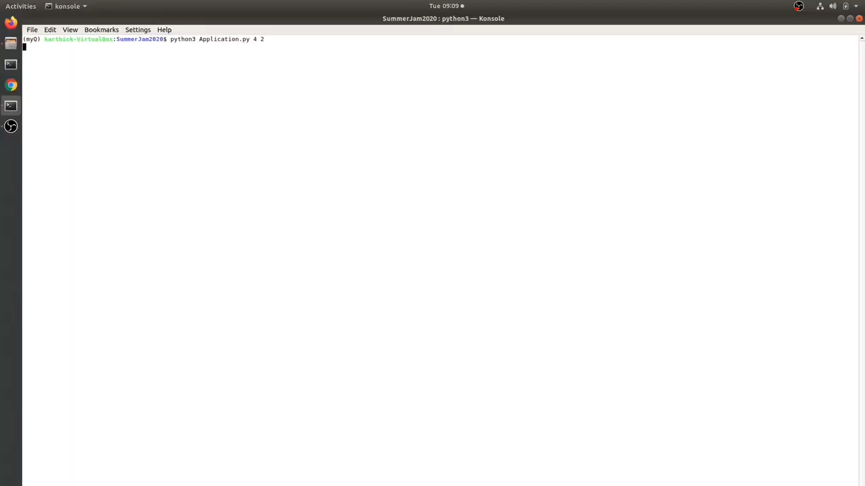
Demo
Notes:
Here is the demo for the first set outcomes that we set to accomplish. Generate an existing pattern to conform to the aesthetic nature of the music.
- The first pattern generated is called ThakaDhina which has the strokes in order (Ta Thom Thom Ki)
- The second pattern generated is called Thakatharikitathaka which has the strokes (Ta, Thaa, Chapu, Thaa, Ki, Ta, Thaa, Ki) in that order and is a very common stroke used to create other patterns
- Another pattern generated is Dhith tham kitu thakatharikitathaka is a 16 stroke pattern which is a combination of the stokes (Cha, Kaarvai, Kaarvai, Kaarvai, Chapu, Kaarvai, Thaa, Ki) and Thakatharikitathaka as mentioned before. But note that it took a lot of times for these patterns to occur suggesting an inconsistency in the probabilistic matrix.
- As expected our Application can also generate interesting new patterns which can be incorporated into a concert setting for contrast. Here is one such example.

Slide 9
Future Work
Applying machine learning to existing strokes to create a robust state transition matrix.
Using these elemental patterns, teach the system to create superstructures from these patterns called “Korvais”
Extending the quantum application to other forms like vocal music and checking if we could come up correct vibratos for corresponding melodic structures.

Slide 10
Bibliography
Open Source Application Pyglet [Pyglet Project]
The Arrival of Quantum Computer by Eduardo R Miranda [Article]
More information about Carnatic Music [Wikipedia]
More about mridangam [Wikipedia]

